Slide 1
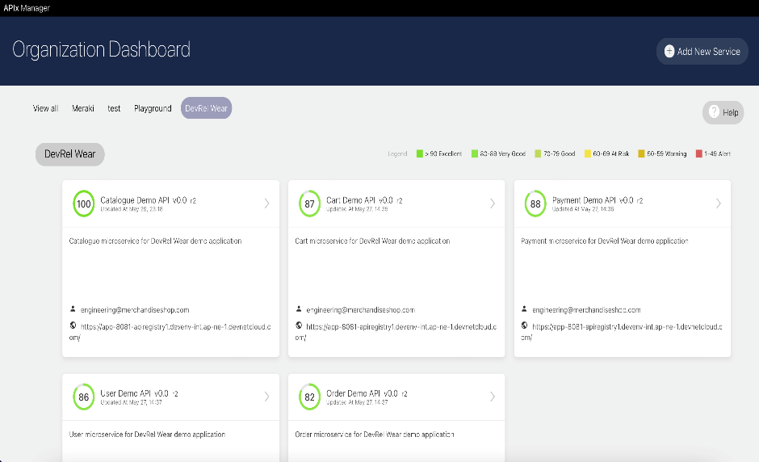
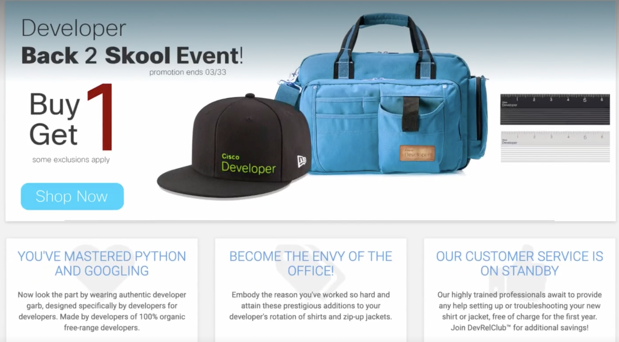
API INSIGHTS OVERVIEW
API Insights is an open source solution that helps developers improve API quality and apply the principle of shift left security.
Here's a tour of how the tool works.
What we are looking at here is the home screen.
Each box represents one microservice.
For example, imagine an application that is built on five microservices and allows you to purchase some cool DevRel merchandise.
Let’s say as a developer, I am adding a new feature to personalize the catalog, which requires updating one of the microservices. I want to make sure this new version aligns with API quality guidelines.
I click on the microservice, and I see this screen that shows the trend analysis of the API quality for previous versions of the microservice.

Slide 2
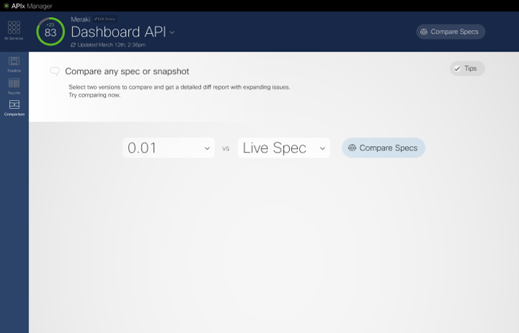
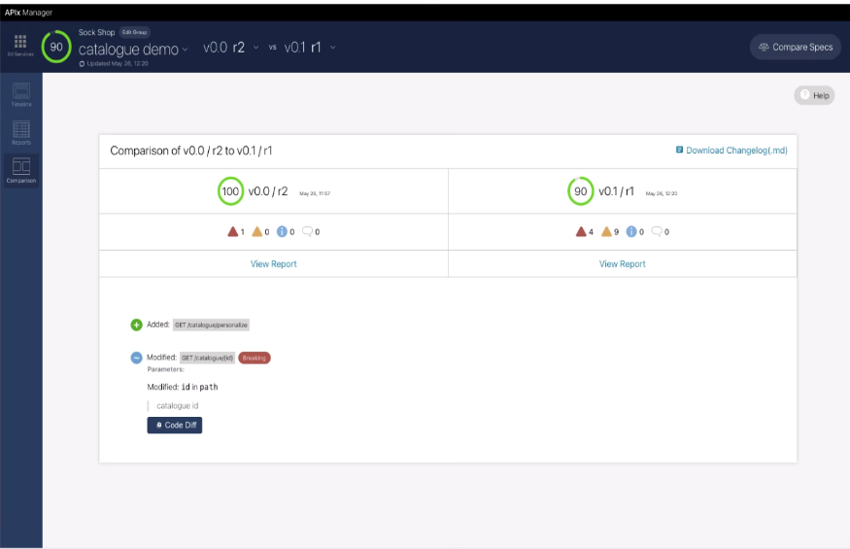
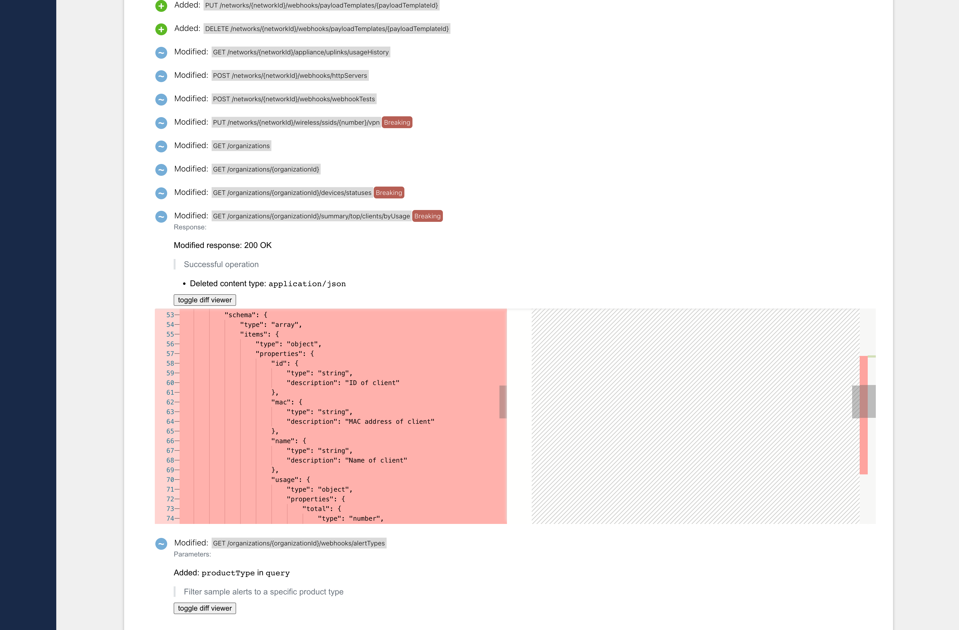
SPEC COMPARE, CHOICE B
SPEC COMPARE READOUT
SPEC COMPARE ITEM EXPAND
Now let’s say you want to see the differences between the new version and the version in production to ensure backward compatibility. Simply select the two versions that you would like to compare, and the analysis will display.
Here we see the new personalization API that was added to enhance the DevRel Wear application.
The modified API in which one parameter type was changed breaks the compatibility of existing code, impacting the applications using this API.
By clicking on Code Diff, you can see error diff details between the two versions, where you can use this information to resolve any issues before releasing the new version.
The new version now has a lower score than the released version due to new errors.
Let’s look at the detailed analysis.
Notes:
To ensure it is backwards compatible and there no security surprises.

Slide 3
CLOSEUP ON PRIORITY ALERT FLAGS
Notice how the tool flags individual API quality findings and categorizes them based on severity. As you can see, the red icon indicates errors identified here that need to be addressed before releasing the code.
You can filter the analysis by specific rule-sets, like API Guideline, inclusive language, Security and Documentation completeness.
Here we have 401 and 403 errors, which are related to missing authentication and authorization behavior specifications.
We also see analysis based on inclusive language rulesets.
The error here flags insensitive language which should be modified.

Slide 4
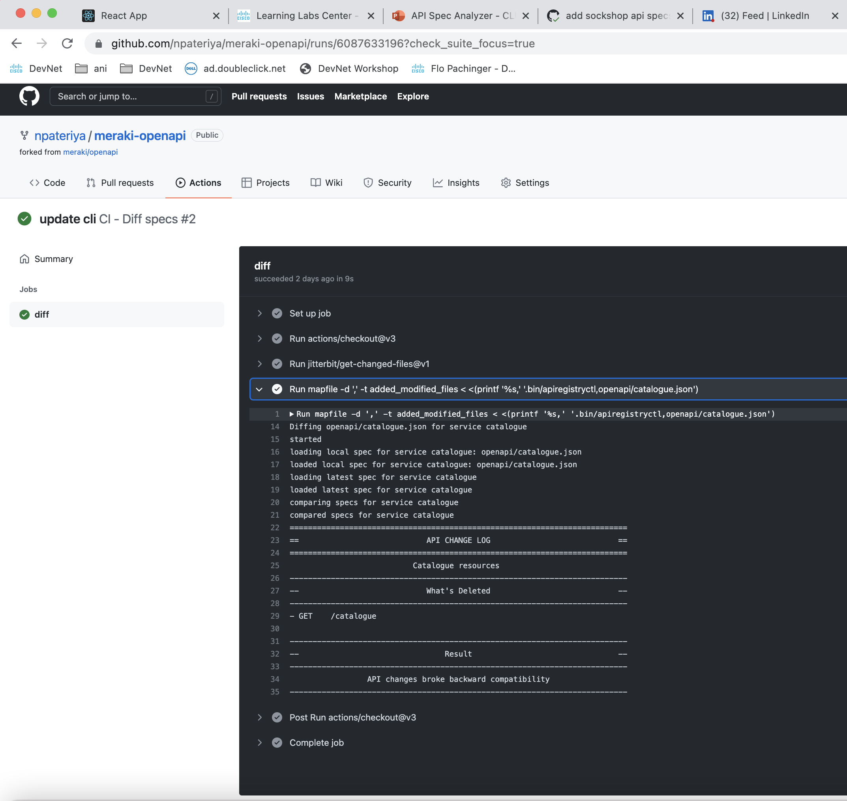
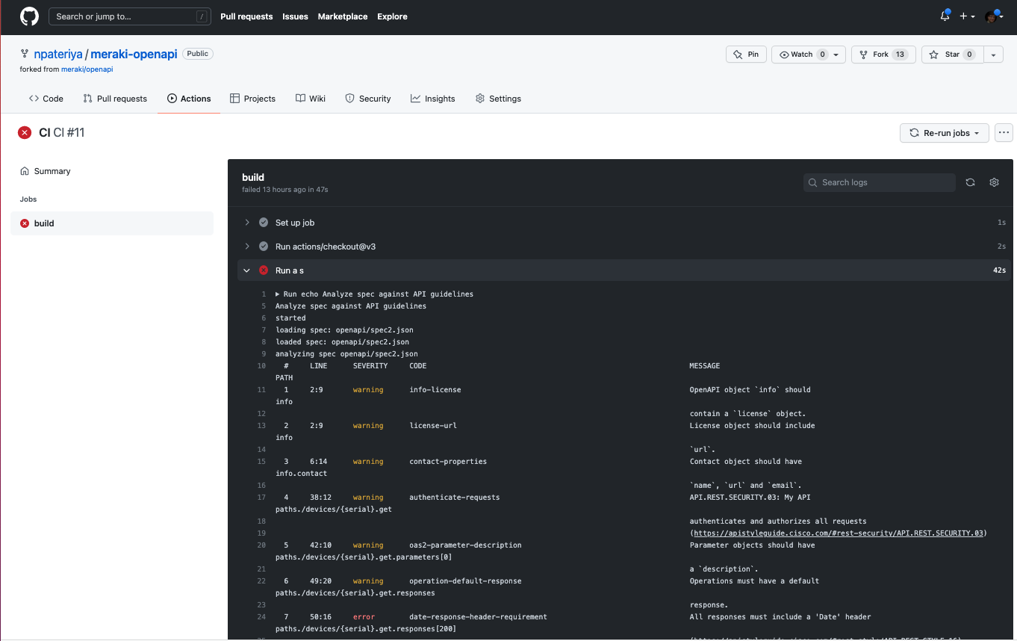
GITHUB, CI/CD
GITHUB, DIFF READOUT
GITHUB, DIFF READOUT
The API Insights UI allows us to visualize what the tool does.
You can also automate this functionality in your CI/CD pipeline, which is the most efficient and scalable way to use API Insights
This gives you the benefit of resolving issues early in the development cycle to improve API quality...
...and apply the principle of Shift Left security.

Slide 5
Add Transition
Shift Left API Quality

Slide 6
Edit MODE
ISSUE DETAIL
GO TO ERROR HOVER
With the VS Code Extension developers can proactively detect and resolve spec related issues within IDE.
More details can be seen by clicking on the issue bar at the bottom.
Hovering over an error, you can see more information about it, including how you can fix it, while clicking on the error takes you directly to the affected line of code.
Once you have installed the API Insights VS Code extension, and as soon as you open the spec file that you are authoring, you can see that API Insights starts to analyze it for any issues.
Notes:
Open local Spec
Analyze
Resolve in context

Slide 7
HOVER ON ISSUE in code
AUTO FIX ISSUE
Here is an example of an error where the API should support https which is more secure, however we see that we only have http
Other errors can be fixed automatically by right-clicking on the bubble in front of the error!
Once the spec file is saved, the error message disappears.
Notes:
Open local Spec
Analyze
Resolve in context

Slide 8
COMPARE SPEC
Details
COMPARE SPEC
In addition, API Insights allows you to compare an updated version of your API against previous versions.
By clicking on the compare icon on the top right, we can select the versions we want to compare. API Insights then identifies the modifications and any breaking changes between them.
Clicking on the error message displays the breaking spec changes side by side within the editor, allowing you to easily fix it.
Notes:
Open local Spec
Analyze
Resolve in context

Slide 9
Transition
Collaborate and Manage your API quality lifecycle
within IDE

Slide 10
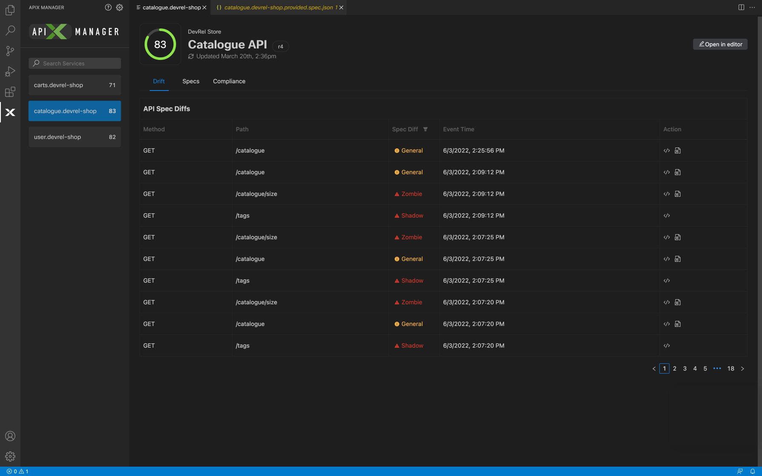
VS CODE, Catalog API
PAN UP TO HEADER
In addition to analyzing a single API that you are working on, you can collaborate with your team members, DevOps, and compliance teams to manage the lifecycle of your APIs.
Clicking on the API Insights logo, you can view all your APIs hosted on the API Insights service.
In this case, we are looking at the catalog microservice.
You can expand the panel to see API quality trends between versions over time.

Slide 11
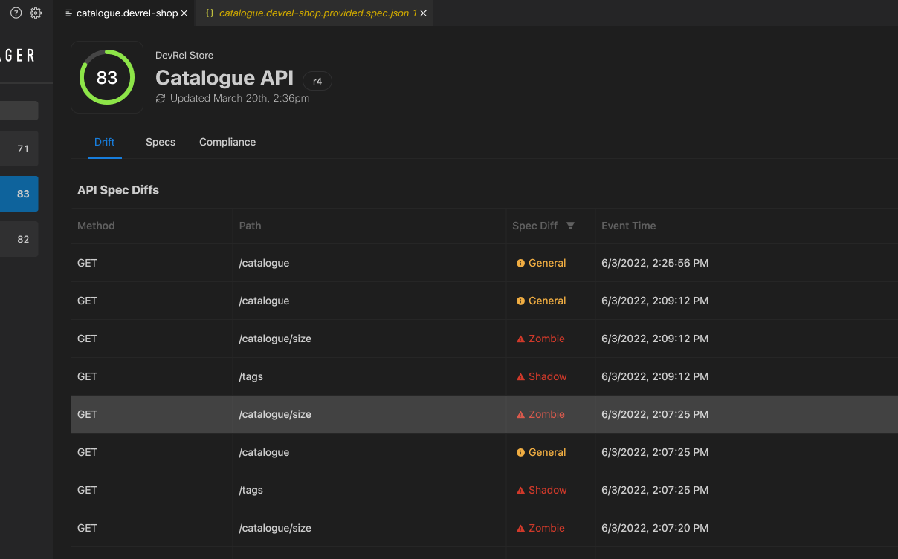
HOVER ON ISSUE
ISSUE DETAIL
You can also see the details of various issues identified.
You can click each issue and see where they are in the context of the code.
Here we can see a blacklist error, as well as a 404 error, that should be fixed.

Slide 12
Add Transition
Shift Right

Slide 13
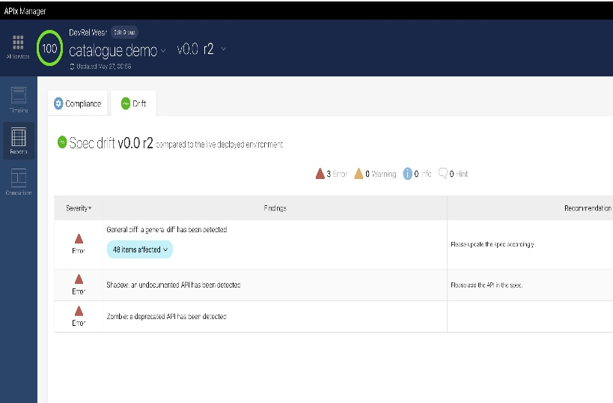
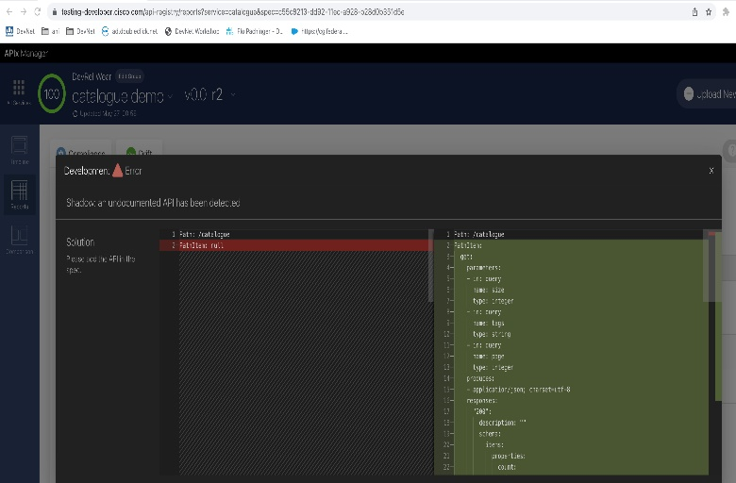
API SPEC ANALYZER -ALL API OVERVIEW
TRANSITION, PAN RIGHT
API SPEC ANALYZER -CX CLOUD
We have seen how to Shift Left with API quality improvements using API Insights VS Code Extension and within a CI/CD pipeline.
Now we can “Shift Right” with API quality improvements after deploying to production.
API Insights' integration with API Clarity, another open-source tool from Cisco, provides run time Drift analysis, which monitors deployed APIs against approved specifications to make sure that the APIs in production don't drift, or deviate, too far from those approved specs.
In addition, it provides visibility into run-time security violations, Shadow & Zombie API calls, and authentication and token issues.

Slide 14
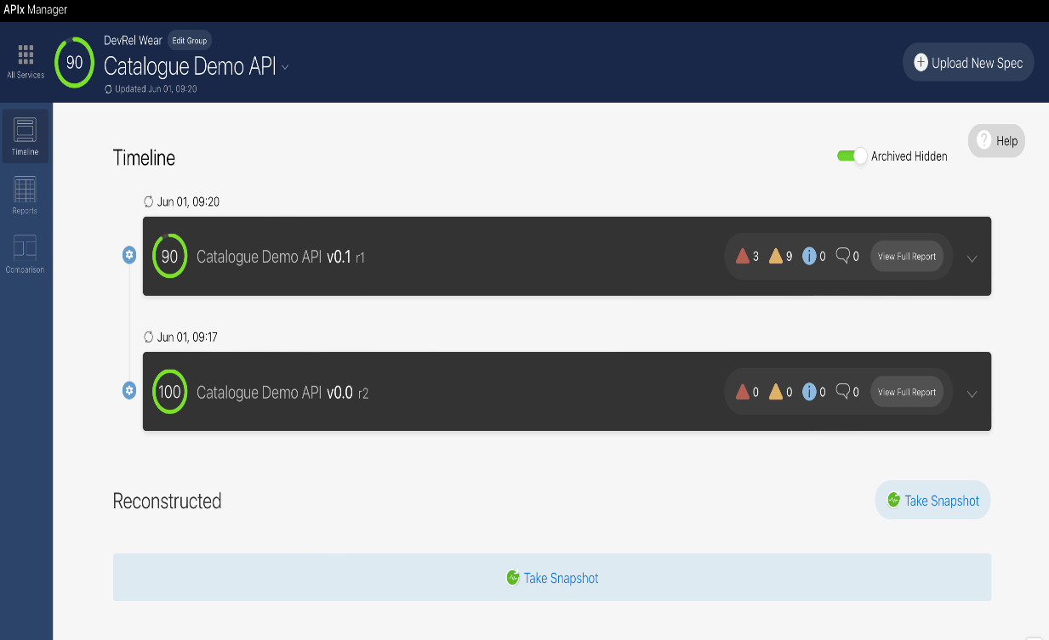
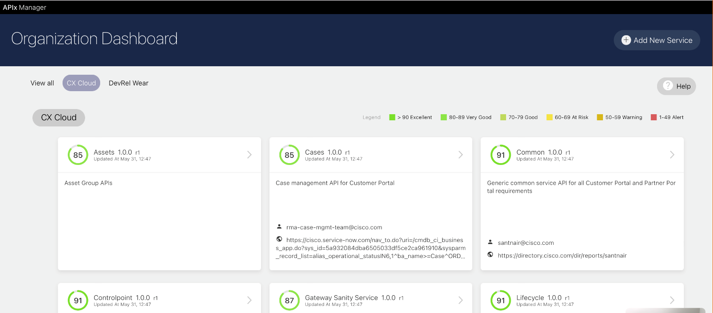
API DASHBOARD, STATIC PULLED FROM RECONSTRUCTED
CX CLOIUD - REPORTS
If there is no API Spec available, API Clarity can also reconstruct a specification from the live API traffic.
Cisco CX Cloud is leveraging these tools to monitor & analyze API quality and compliance in-real time and address issues pro-actively in their CI/CD pipeline.
You can too!
We also provide an open-source binary that you can leverage and integrate with your CI/CD pipelines.
Notes:
Add which parts this is build out of CX cloud provided host the applications behind API Gateway.
Runtime insights from Panoptica and API Clarity

Slide 15
To Improve your developer experience
Download and Star the API Insights repo today

